Slide 1




Mathematical Foundations
BERTScore Text Evaluation
using the Bible
Vo Nguyen
Authors: Zhang, T., Kishore, V., Wu, F., Weinberger, K. Q., & Artzi, Y.
Notes:
Good afternoon everyone. We are excited to share our journey and delve into creating innovative analysis tools

Slide 2





Overview of BERTScore
1) BERTScore Introduction
Building a set of generalizable tools and methods to expedite the analysis of log events
2) Bible Translation Example
Creating an interactive assistant interface to aid support engineers in resolving tickets with increased efficiency
Notes:
Essentially creating a method that could applied to any program and allowed the relevant support engineers to quickly analyze and understand potential problems.

Slide 3


BERTScore Introduction
What is BERTScore?
Definition: An emerging evaluation metric for evaluating the quality of text generation models for GPT, RAG and other new BLP/AI Techniques.
Purpose: Importance of Translation and Quality of Text Comparisons
Example: We will highlight the measure of semantic similarity in crucial applications such as Bible translation and accuracy in using the first Book of Joshua in ESV (English Standard Version), CEV (Contemporary Version), and GPT-4 generated contemporary version on ESV to see how well it does.
Notes:
Looking at the log data provided we see a ton of potential. With over 20 columns combined with a verbose message string. Traditional log analysis methodologies revolve around sorting, filtering, and searching values in the dataset. We wanted to explore how we could take full advantage of the detailed messages. The primary concern for this is the messages are different from typical sentences in both structure and syntax.

Slide 4

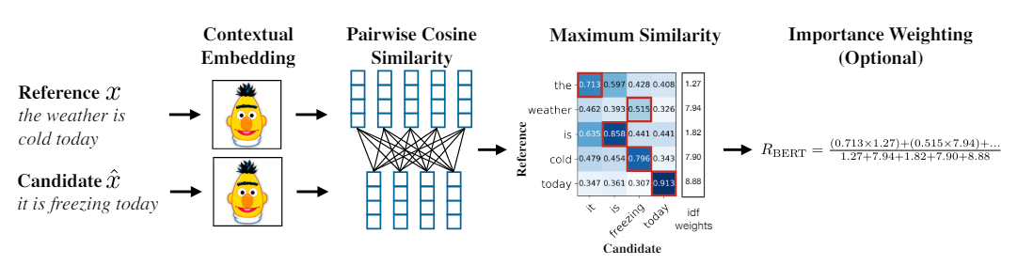
BERTScore Architecture
Contextual Embeddings: BERT generates embeddings that has a deep contextualizaed word representation to capture characteristic of words such as syntax and semantics and how they are different across contexts.
Cosine Similarity (Pairwise & Maximum): BERTScore calculates the cosine similarity between embeddings of tokens and the source text, evaluating how closely the meanings align.
Notes:
Our application’s methods start with existing tools and metrics. Data points such as file size, start and end times, and messages per second provide perspective when looking at a chunk of data that has suspected answers to our questions. For the dataset used in this presentation, there are just under a million log events over 10 minutes. Extracting and documenting this information is valuable for engineers and the AI solutions we propose later in this presentation.

Slide 5
Reference & Candidate
Extracting Understanding from Messages
Assumption: Context of abnormal data is different than that of normal data
Sample Log
BERT
in-connection12270(G21-404):session12271: Remove link42567 (local handle=5, remote handle=5, name=G21:125360:VEHICLE_SERVICE
Leverage message content
Circumvent explicit parsing, increasing generalizability
Build contextual and semantic relationships for messages
in[NUM]connection[NUM]G[NUM][NUM]G[NUM]session[NUM] Remove link[NUM]local handle[NUM]remote handle[NUM]nameG[NUM]VEHICLE[NUM]SERVICE[NUM]
Sample Anomalous Log
Aborting messaging object. Name = qc-sbus-001:topic:construct_test_pack_tracker~175|construct_test_pack_tracker, Object type = Microsoft.ApplicationServer.Messaging.Broker.AmqpMessageConsumer, Reason = The operation did not complete within the allotted timeout of 00:02:00.
Notes:
We want to extract the contextual understanding from the messages associated with each log file, with the following assumption.
Since our approach removes most numerical information, we want to pull as much information out of the messages for anomaly detection.
Circumvent explicit parsing of log files, increasing general application to many programs
Build contextual and semantic relationships for messages, which traditional ML models fail to utilize.
**We are removing the numbers to remove the noise and look at the alphabet data, massing the numbers. “

Slide 6
Pairwise Cosine Similarity
Extracting Understanding from Messages
Assumption: Context of abnormal data is different than that of normal data
Sample Log
BERT
in-connection12270(G21-404):session12271: Remove link42567 (local handle=5, remote handle=5, name=G21:125360:VEHICLE_SERVICE
Leverage message content
Circumvent explicit parsing, increasing generalizability
Build contextual and semantic relationships for messages
in[NUM]connection[NUM]G[NUM][NUM]G[NUM]session[NUM] Remove link[NUM]local handle[NUM]remote handle[NUM]nameG[NUM]VEHICLE[NUM]SERVICE[NUM]
Sample Anomalous Log
Aborting messaging object. Name = qc-sbus-001:topic:construct_test_pack_tracker~175|construct_test_pack_tracker, Object type = Microsoft.ApplicationServer.Messaging.Broker.AmqpMessageConsumer, Reason = The operation did not complete within the allotted timeout of 00:02:00.
Notes:
We want to extract the contextual understanding from the messages associated with each log file, with the following assumption.
Since our approach removes most numerical information, we want to pull as much information out of the messages for anomaly detection.
Circumvent explicit parsing of log files, increasing general application to many programs
Build contextual and semantic relationships for messages, which traditional ML models fail to utilize.
**We are removing the numbers to remove the noise and look at the alphabet data, massing the numbers. “

Slide 7
Maximum Similarity
Extracting Understanding from Messages
Assumption: Context of abnormal data is different than that of normal data
Sample Log
BERT
in-connection12270(G21-404):session12271: Remove link42567 (local handle=5, remote handle=5, name=G21:125360:VEHICLE_SERVICE
Leverage message content
Circumvent explicit parsing, increasing generalizability
Build contextual and semantic relationships for messages
in[NUM]connection[NUM]G[NUM][NUM]G[NUM]session[NUM] Remove link[NUM]local handle[NUM]remote handle[NUM]nameG[NUM]VEHICLE[NUM]SERVICE[NUM]
Sample Anomalous Log
Aborting messaging object. Name = qc-sbus-001:topic:construct_test_pack_tracker~175|construct_test_pack_tracker, Object type = Microsoft.ApplicationServer.Messaging.Broker.AmqpMessageConsumer, Reason = The operation did not complete within the allotted timeout of 00:02:00.
Notes:
We want to extract the contextual understanding from the messages associated with each log file, with the following assumption.
Since our approach removes most numerical information, we want to pull as much information out of the messages for anomaly detection.
Circumvent explicit parsing of log files, increasing general application to many programs
Build contextual and semantic relationships for messages, which traditional ML models fail to utilize.
**We are removing the numbers to remove the noise and look at the alphabet data, massing the numbers. “

Slide 8
Importance Weighting
Extracting Understanding from Messages
Assumption: Context of abnormal data is different than that of normal data
Sample Log
BERT
in-connection12270(G21-404):session12271: Remove link42567 (local handle=5, remote handle=5, name=G21:125360:VEHICLE_SERVICE
Leverage message content
Circumvent explicit parsing, increasing generalizability
Build contextual and semantic relationships for messages
in[NUM]connection[NUM]G[NUM][NUM]G[NUM]session[NUM] Remove link[NUM]local handle[NUM]remote handle[NUM]nameG[NUM]VEHICLE[NUM]SERVICE[NUM]
Sample Anomalous Log
Aborting messaging object. Name = qc-sbus-001:topic:construct_test_pack_tracker~175|construct_test_pack_tracker, Object type = Microsoft.ApplicationServer.Messaging.Broker.AmqpMessageConsumer, Reason = The operation did not complete within the allotted timeout of 00:02:00.
Notes:
We want to extract the contextual understanding from the messages associated with each log file, with the following assumption.
Since our approach removes most numerical information, we want to pull as much information out of the messages for anomaly detection.
Circumvent explicit parsing of log files, increasing general application to many programs
Build contextual and semantic relationships for messages, which traditional ML models fail to utilize.
**We are removing the numbers to remove the noise and look at the alphabet data, massing the numbers. “

Slide 9

Contextual Analysis
Extracting Understanding from Messages
Assumption: Context of abnormal data is different than that of normal data
Sample Log
BERT
in-connection12270(G21-404):session12271: Remove link42567 (local handle=5, remote handle=5, name=G21:125360:VEHICLE_SERVICE
Leverage message content
Circumvent explicit parsing, increasing generalizability
Build contextual and semantic relationships for messages
in[NUM]connection[NUM]G[NUM][NUM]G[NUM]session[NUM] Remove link[NUM]local handle[NUM]remote handle[NUM]nameG[NUM]VEHICLE[NUM]SERVICE[NUM]
Sample Anomalous Log
Aborting messaging object. Name = qc-sbus-001:topic:construct_test_pack_tracker~175|construct_test_pack_tracker, Object type = Microsoft.ApplicationServer.Messaging.Broker.AmqpMessageConsumer, Reason = The operation did not complete within the allotted timeout of 00:02:00.
Notes:
We want to extract the contextual understanding from the messages associated with each log file, with the following assumption.
Since our approach removes most numerical information, we want to pull as much information out of the messages for anomaly detection.
Circumvent explicit parsing of log files, increasing general application to many programs
Build contextual and semantic relationships for messages, which traditional ML models fail to utilize.
**We are removing the numbers to remove the noise and look at the alphabet data, massing the numbers. “

Slide 10
Contextual Analysis
Extracting Understanding from Messages
Assumption: Context of abnormal data is different than that of normal data
Sample Log
BERT
in-connection12270(G21-404):session12271: Remove link42567 (local handle=5, remote handle=5, name=G21:125360:VEHICLE_SERVICE
Leverage message content
Circumvent explicit parsing, increasing generalizability
Build contextual and semantic relationships for messages
in[NUM]connection[NUM]G[NUM][NUM]G[NUM]session[NUM] Remove link[NUM]local handle[NUM]remote handle[NUM]nameG[NUM]VEHICLE[NUM]SERVICE[NUM]
Sample Anomalous Log
Aborting messaging object. Name = qc-sbus-001:topic:construct_test_pack_tracker~175|construct_test_pack_tracker, Object type = Microsoft.ApplicationServer.Messaging.Broker.AmqpMessageConsumer, Reason = The operation did not complete within the allotted timeout of 00:02:00.
Notes:
We want to extract the contextual understanding from the messages associated with each log file, with the following assumption.
Since our approach removes most numerical information, we want to pull as much information out of the messages for anomaly detection.
Circumvent explicit parsing of log files, increasing general application to many programs
Build contextual and semantic relationships for messages, which traditional ML models fail to utilize.
**We are removing the numbers to remove the noise and look at the alphabet data, massing the numbers. “

Slide 11
Contextual Analysis
Extracting Understanding from Messages
Assumption: Context of abnormal data is different than that of normal data
Sample Log
BERT
in-connection12270(G21-404):session12271: Remove link42567 (local handle=5, remote handle=5, name=G21:125360:VEHICLE_SERVICE
Leverage message content
Circumvent explicit parsing, increasing generalizability
Build contextual and semantic relationships for messages
in[NUM]connection[NUM]G[NUM][NUM]G[NUM]session[NUM] Remove link[NUM]local handle[NUM]remote handle[NUM]nameG[NUM]VEHICLE[NUM]SERVICE[NUM]
Sample Anomalous Log
Aborting messaging object. Name = qc-sbus-001:topic:construct_test_pack_tracker~175|construct_test_pack_tracker, Object type = Microsoft.ApplicationServer.Messaging.Broker.AmqpMessageConsumer, Reason = The operation did not complete within the allotted timeout of 00:02:00.
Notes:
We want to extract the contextual understanding from the messages associated with each log file, with the following assumption.
Since our approach removes most numerical information, we want to pull as much information out of the messages for anomaly detection.
Circumvent explicit parsing of log files, increasing general application to many programs
Build contextual and semantic relationships for messages, which traditional ML models fail to utilize.
**We are removing the numbers to remove the noise and look at the alphabet data, massing the numbers. “

Slide 12
Contextual Analysis
Extracting Understanding from Messages
Assumption: Context of abnormal data is different than that of normal data
Sample Log
BERT
in-connection12270(G21-404):session12271: Remove link42567 (local handle=5, remote handle=5, name=G21:125360:VEHICLE_SERVICE
Leverage message content
Circumvent explicit parsing, increasing generalizability
Build contextual and semantic relationships for messages
in[NUM]connection[NUM]G[NUM][NUM]G[NUM]session[NUM] Remove link[NUM]local handle[NUM]remote handle[NUM]nameG[NUM]VEHICLE[NUM]SERVICE[NUM]
Sample Anomalous Log
Aborting messaging object. Name = qc-sbus-001:topic:construct_test_pack_tracker~175|construct_test_pack_tracker, Object type = Microsoft.ApplicationServer.Messaging.Broker.AmqpMessageConsumer, Reason = The operation did not complete within the allotted timeout of 00:02:00.
Notes:
We want to extract the contextual understanding from the messages associated with each log file, with the following assumption.
Since our approach removes most numerical information, we want to pull as much information out of the messages for anomaly detection.
Circumvent explicit parsing of log files, increasing general application to many programs
Build contextual and semantic relationships for messages, which traditional ML models fail to utilize.
**We are removing the numbers to remove the noise and look at the alphabet data, massing the numbers. “

Slide 13
Contextual Analysis
Extracting Understanding from Messages
Assumption: Context of abnormal data is different than that of normal data
Sample Log
BERT
in-connection12270(G21-404):session12271: Remove link42567 (local handle=5, remote handle=5, name=G21:125360:VEHICLE_SERVICE
Leverage message content
Circumvent explicit parsing, increasing generalizability
Build contextual and semantic relationships for messages
in[NUM]connection[NUM]G[NUM][NUM]G[NUM]session[NUM] Remove link[NUM]local handle[NUM]remote handle[NUM]nameG[NUM]VEHICLE[NUM]SERVICE[NUM]
Sample Anomalous Log
Aborting messaging object. Name = qc-sbus-001:topic:construct_test_pack_tracker~175|construct_test_pack_tracker, Object type = Microsoft.ApplicationServer.Messaging.Broker.AmqpMessageConsumer, Reason = The operation did not complete within the allotted timeout of 00:02:00.
Notes:
We want to extract the contextual understanding from the messages associated with each log file, with the following assumption.
Since our approach removes most numerical information, we want to pull as much information out of the messages for anomaly detection.
Circumvent explicit parsing of log files, increasing general application to many programs
Build contextual and semantic relationships for messages, which traditional ML models fail to utilize.
**We are removing the numbers to remove the noise and look at the alphabet data, massing the numbers. “

Slide 14
Contextual Analysis
Extracting Understanding from Messages
Assumption: Context of abnormal data is different than that of normal data
Sample Log
BERT
in-connection12270(G21-404):session12271: Remove link42567 (local handle=5, remote handle=5, name=G21:125360:VEHICLE_SERVICE
Leverage message content
Circumvent explicit parsing, increasing generalizability
Build contextual and semantic relationships for messages
in[NUM]connection[NUM]G[NUM][NUM]G[NUM]session[NUM] Remove link[NUM]local handle[NUM]remote handle[NUM]nameG[NUM]VEHICLE[NUM]SERVICE[NUM]
Sample Anomalous Log
Aborting messaging object. Name = qc-sbus-001:topic:construct_test_pack_tracker~175|construct_test_pack_tracker, Object type = Microsoft.ApplicationServer.Messaging.Broker.AmqpMessageConsumer, Reason = The operation did not complete within the allotted timeout of 00:02:00.
Notes:
We want to extract the contextual understanding from the messages associated with each log file, with the following assumption.
Since our approach removes most numerical information, we want to pull as much information out of the messages for anomaly detection.
Circumvent explicit parsing of log files, increasing general application to many programs
Build contextual and semantic relationships for messages, which traditional ML models fail to utilize.
**We are removing the numbers to remove the noise and look at the alphabet data, massing the numbers. “

Slide 15

Anomaly Detection
LAnoBERT
Log Anomaly Detection on BERT
Unsupervised Approach:
Execution:
Train LAnoBERT on a normal subset of the data
Build an anomaly score algorithm
Score a dataset that contains both normal and anomalous logs
Pick out anomalies with high scores
Advantages:
Doesn’t suffer from biased datasets
Model can be trained on any nominal data
Uses context to score anomalous files for isolation
Notes:
Our Naïve model only output an accuracy of 70% when isolating abnormal log files from a test set, which indicated that we would need to iterate and improve the design of the model, or atleast look at other methods.
We used this as intuition for developing statistically driven methods for isolating log files for the rest of our workflow.
**BIG IDEA**
Train BERT on normal data and then testing test has the anomalies in them.

Slide 16

Log Analysis
Anomaly Detection
Meta Data Analysis
Signal Analysis
Anomaly Detection
Log Frequency
LAnoBERT
Filtered Log Subset
Notes:
Anomaly detection is the crux of log analysis. Most white papers consider an anomaly a single log event error and a binary classification. However, this is an oversimplified abstraction and is often useless as the events can already labeled as errors. Anomalies can be a group of messages or a spike in message frequency that may or may not lead to documented errors. They can be a series of failed login attempts suggesting nefarious actors. Building out methods and tools for capturing the full breadth of anomalies is incredibly difficult but valuable. This is an area for improvement.
To do this, we suggest a wide variety of anomaly detection methods. The primary goal of this stage of anomaly detection is to help narrow down the data size for more computationally complex methods in the next level of analysis.
**Using Log Frequency then LAnoBert to narrow down to the filtered log subset

Slide 17
GenAI / ML Pipeline
Methodology
Notes:
Thank you Abhay! In this section, we'll dive into an in-depth analysis of our Generative AI pipeline for error log analysis.

Slide 18

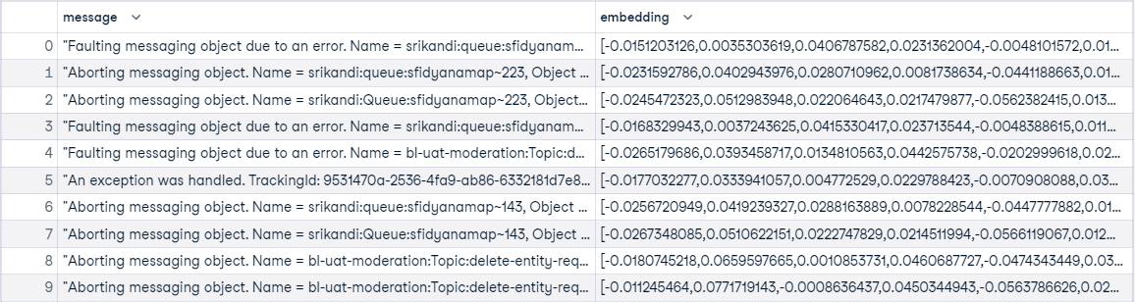



GenAI / ML Pipeline
1
Embedding Model
2
4
Applications
Text Embeddings
Anomaly Detection
Filtered Log Subset
Unsupervised Learning
Summaries
Text – Embedding – Small – 3*
Isolation Forest
Recommendations
2
Clustering
3
Generative AI
Unsupervised Learning
Log Analysis Assistant
(RAG)
K-Means Cluster
Solutions
3
Summarize Clusters
Application
User Interface
LLM Completions (GPT 4 Turbo)
+ Prompt Engineering
Generative AI
Notes:
Starting with the focused dataset output, we applied the Text-Embedding-Small -3 model on our preprocessed log data. This pivotal step allowed us to transform error log messages into high-dimensional vectors, setting the stage for sophisticated unsupervised learning techniques, (NEXT) including K-Means Clustering and Isolation Forest. (NEXT)
Our journey into intelligent solutions begins with combining Large Language Models (LLMs) and strategic Prompt Engineering to analyze our clustering groups. (NEXT) Which we will then take our Log Errors Analysis and run through Log Analysis Chatbot which is our rag. Additionally, by applying Isolation Forest, we further refine our anomaly detection process. The culmination of these efforts is presented through an Applications sucha s Summaries, Classifications, and Recommendations. Lastly we will demo an Application user Interface for Software Engineers to use for these applications and as a AskLogErrors. (NEXT)

Slide 19

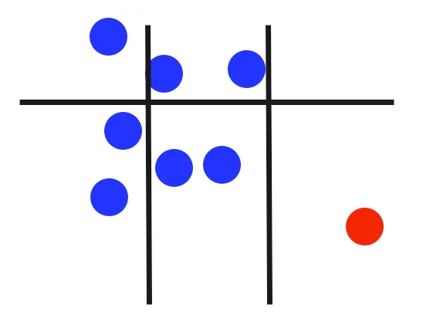


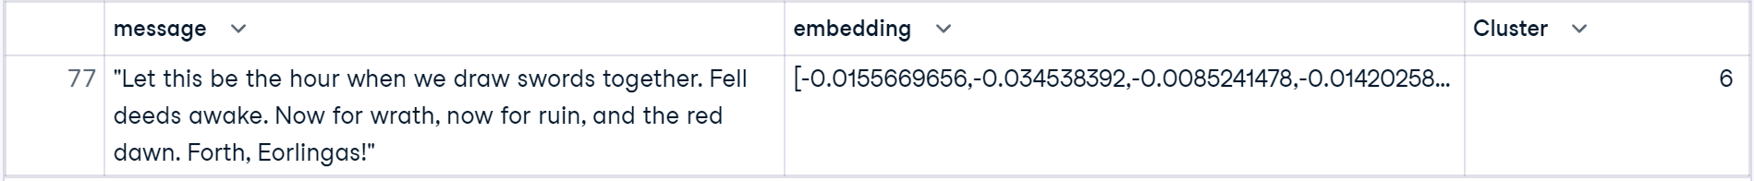


Unsupervised Learning Method #1
Isolation Forest Performance
Isolation Forest (Anomaly Dataset) - Successful
Isolation Forest (Filtered Dataset)
Log Analysis Assistant
(Retrieval Augmented Generation)
Isolation Forest
Notes:
In our second unsupervised learning method, A particularly intriguing discovery was made with our Isolation Forest technique. By introducing an anomaly—specifically, a quote from Lord of the Rings—our model promptly identified it within our dataset. This experiment not only demonstrated the model's precision but also highlighted its potential in uncovering unique insights when applied to our dataset without the anomaly. Now taking this an applying it our real filtered dataset, we can see that error log message number 15 might be an anomaly, so we will take it and feed it to our LAC further details.
Interesting note, when we ran the K-Means cluster, the lord of the rings quote was grouped with Entity Size Error Log Messages. Maybe this could be the anomaly group. Interesting insights that we hope the LAC can answer for us.

Slide 20
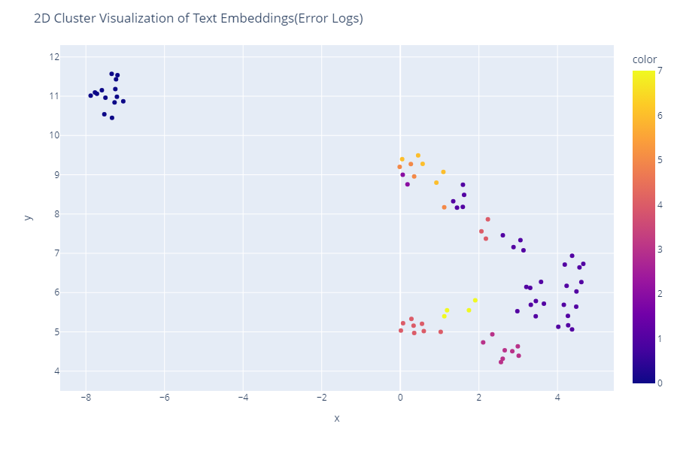
Unsupervised Learning Method #2
Message | Cluster
Entity size become negative. Entity name = trac … | 0
Entity size become negative. Entity name = trac … | 0
Aborting messaging object. Name = mcapesea … | 1
Aborting messaging object. Name = mcapesea … | 1
Aborting messaging object. Name = mcapesea … | 1
… | …
Protocol Client of type of ‘AmqpMessageConsuder … | 2
Protocol Client of type of ‘AmqpMessageConsuder … | 2
…
"Amqp publish failed. TrackingId: | 3
"An exception was handled. TrackingId: | 3
…
"The AmqpProtocolClient is being closed … | 8
"The AmqpProtocolClient is being closed … | 8
"The AmqpProtocolClient is being closed … | 8
K-Means Cluster = 9
Cluster 1
Cluster 0
Notes:
Our exploration into K-Means Clustering revealed fascinating insights, with error messages naturally grouping into nine clusters. There are optimization methods for determing K using Silhouette Scores and Elbow Method. This was confirmed through meticulous analysis, ensuring the logical grouping of messages based on their similarities. If you see look here on the table, the messages are grouped by similar of words and phrases from the error log messages. This can prove useful in understanding what the common trends are.
There are a ton of research that looks like the separation of clusters and as well as distance between each grouping that we didn’t get a chance to look at.

Slide 21



Generative AI General Knowledge (LLM)
Log Analysis on Group Clustering using LLM Completions
Sample 10 Messages
Cluster 0
Cluster 0
Log(Retrieval Augmented Generation)
Analysis Assistant
Fine-Tuning LLM
+ Prompt Engineering
Cluster 1
Cluster 1
Cluster 2
Cluster 2
Chat GPT 4.5 Turbo
Cluster 3
Cluster 3
Cluster 4
Cluster 4
Cluster 5
Cluster 5
Configuration:
Temperature = 0.05
Max Tokens = 300
Top P = 1
Prompt (Outputs):
Summarize:
Summaries of Each Log
Find Anomalies/Patterns:
GPT Text Output for Anomalies / Patterns
Cluster 6
Cluster 6
Cluster 7
Cluster 7
Cluster 8
Cluster 8
Notes:
Advancing to our Generative AI solutions called Log Analysis on Group Clustering using LLM Completions. We employed LLM completions to delve into the cluster groups. This process involved selecting representative messages from each cluster and processing them through a fine-tuned LLM, such as ChatGPT 4.5 Turbo. Our prompts aimed at summarizing, finding anomalies, and identifying patterns, which were then analyzed by our Log Analysis Chatbot for a comprehensive understanding.
I'll now pass the baton to Derek, who will delve deeper into our advanced applications.

Slide 22
Log Analysis Assistant & Streamlit
User Application

Slide 23

Generative AI Specific Knowledge (RAG)
Log Analysis RAG
Retrieval-augmented generation (RAG) LLMs retrieve relevant information from a dataset and use that context to respond.
The LAA contains information such as:
Troubleshooting Documentation
Meta/Signal Data
Cluster Summaries
Anomaly from Isolation Forest
https://chat.openai.com/g/g-kqO9aKha4-log-analysis-assistant
Notes:
In its final implementation, the LAC defines its knowledge base from the cluster results as well as the Azure Service bus documentation, metadata, signal analysis, and isolation forest. The LAC directly interacts with the user, helping them look up information, interpret results, and provide remediation suggestions.

Slide 24

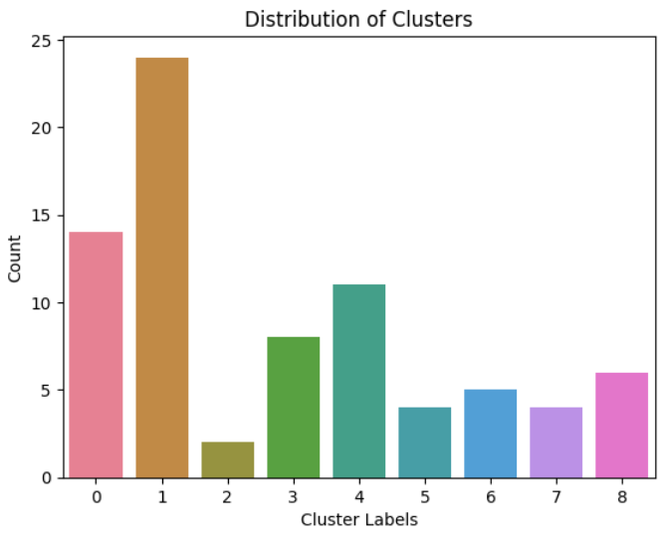
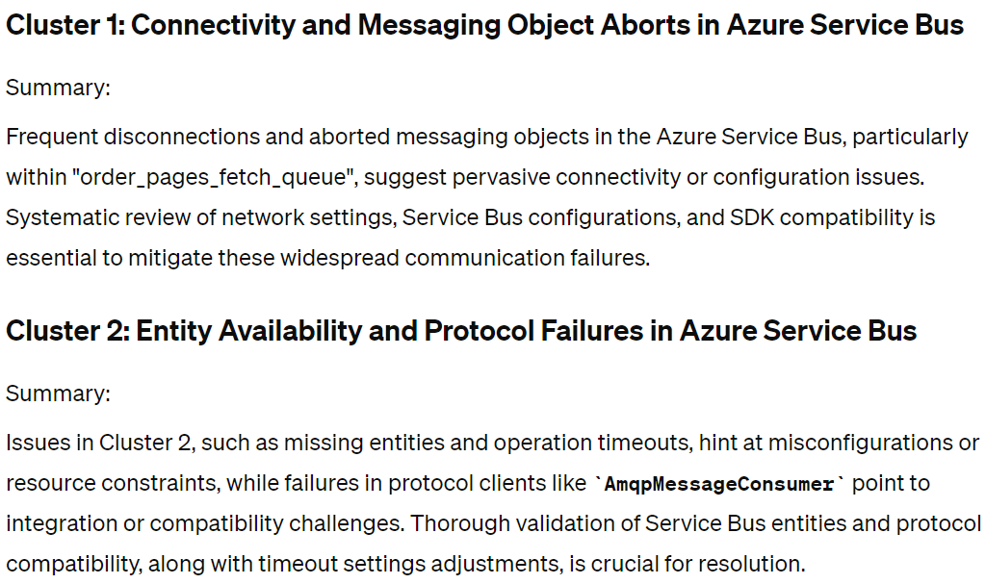
RAG - Results
Summaries & Classifications
Isolation Forest (Filtered Dataset)
https://chat.openai.com/g/g-kqO9aKha4-log-analysis-assistant
Notes:
Here is an example of the LAC relaying cluster summaries requested in a prompt to help the support engineer understand the context of error logs during the significant spike in log event frequency.

Slide 25
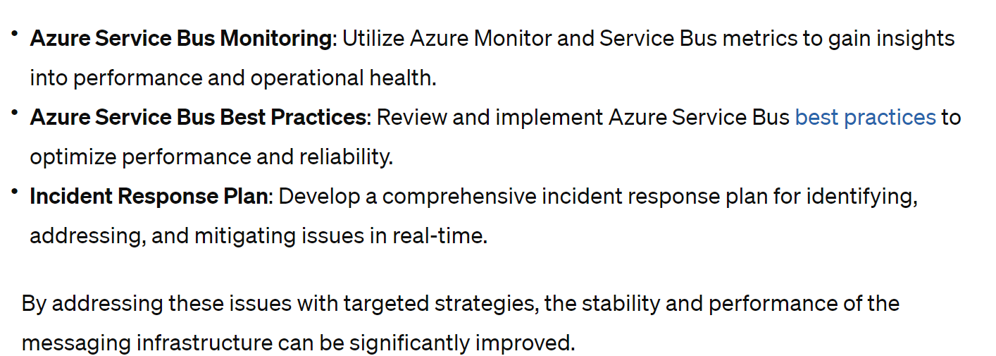
RAG- Results
Recommendations
https://chat.openai.com/g/g-kqO9aKha4-log-analysis-assistant
Notes:
Here, the LAC suggests tools for specific tasks and links the user to relevant documentation. We prompted it by asking for general recommendations. As is, our group lacks the documentation and domain knowledge to make any specific suggestions, but with the proper documentation added to the knowledgebase, the log analysis assistant can help provide more specific solutions.

Slide 26
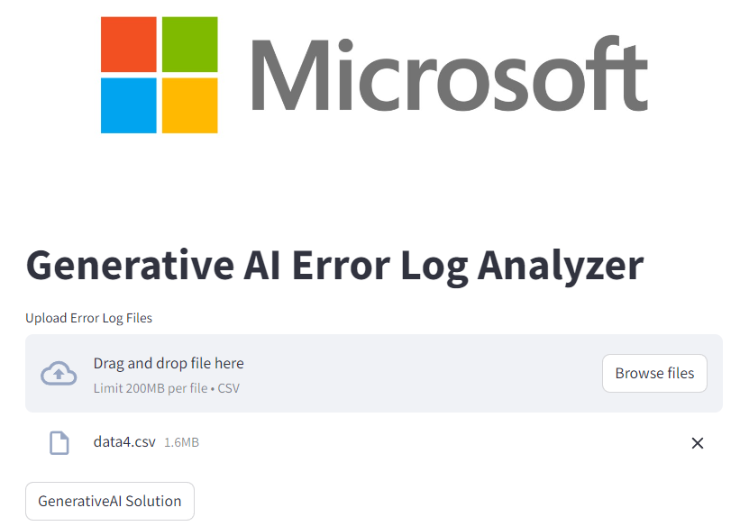
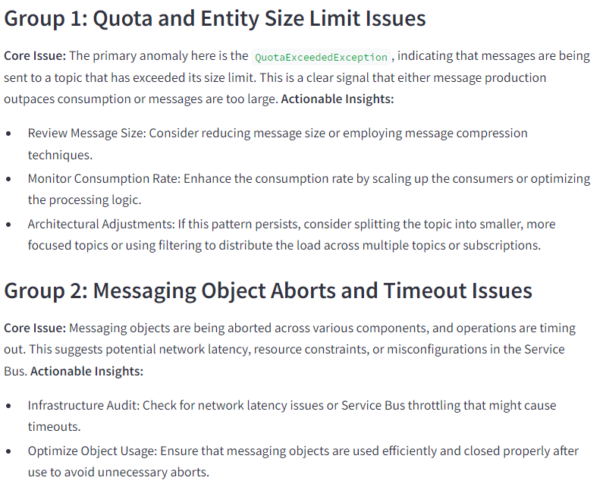
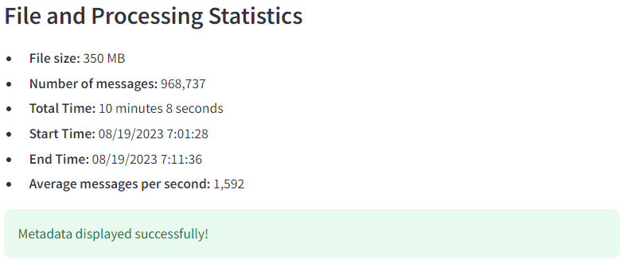
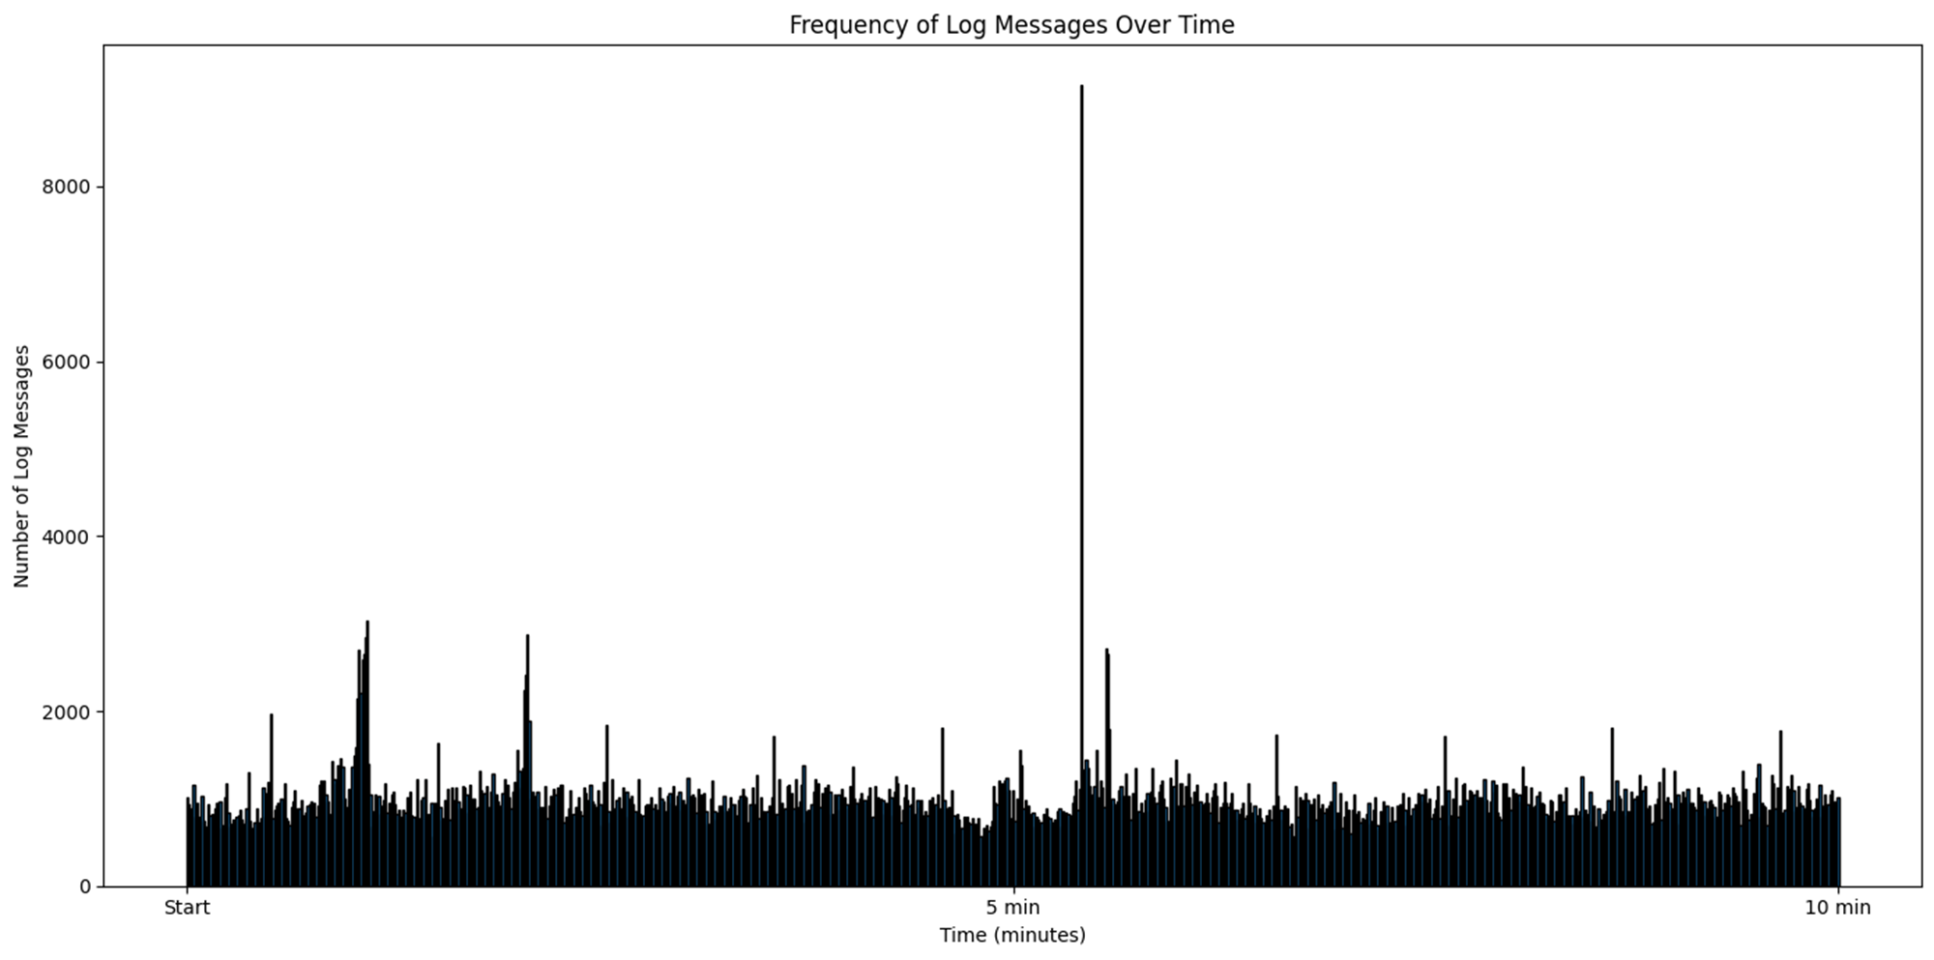

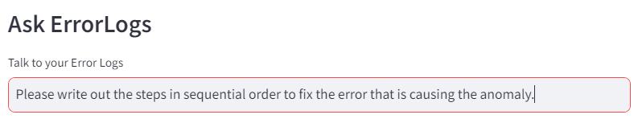
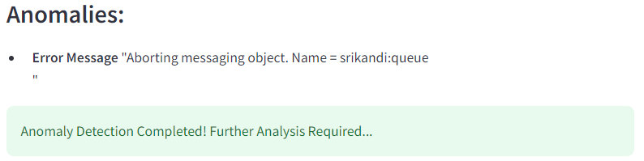
User Interface Streamlit Application
Notes:
In our user interface application, we have demo application where we will present this to Microsoft. Starting off with meta data analysis displaying file, size, number of messages, total time, and such. Next is anomalies using isolation forest to output which of the following is a possible anomaly for the AI to study and evaluate using our RAG. Next is a summary and recommendations of what each group of log messages could be. And finally, and main feature is a AskErrorLogs, where we can simply ask the error log to write out the steps to fix the error that is causing the anomaly.

Slide 27


Final Thoughts
Conclusion
Nuance and complexity
Multiple approaches and architectures required
A robust tool is a sum of multiple models
With advancements by LLMs, and some intelligent design, we can provide a unique way to ‘talk’ with and gain insights from log datasets.
Notes:
In Conclusion, some of the key take aways that we took from this project:
When analyzing log files, there is a lot of nuance and complexity when breaking down the data.
There are multiple approaches and architectures that are required to build a robust suite of log analysis tools
Our robust tooling is a result of multiple models, coming together to paint the most informative summary with our generative tools.
With applications of LLMs, along with some intelligent design, we can provide a unique way for support engineers to gain insights and ‘talk’ with their dataset, to sufficiently expedite support solutions.

Slide 28





Thank you!
Abhay Sharma
Derek Rogers
abhays9217@gmail.com
www.linkedin.com/in/abhays9217/
Vo Nguyen
DerekGRogers1@gmail.com
www.linkedin.com/in/DerekGRogers1/
VoChanNguyen@gmail.com
www.linkedin.com/in/vochannguyen/

